Slide 1
ARM PROCESSOR
K.S.V.SAMBASIVARAO
HEAD
DEP.OF.ELECTRONICS

Slide 2
ARM PROCESSOR:
The ARM was originally developed at Acorn Computers Limited of Cambridge , England, between 1983 and 1985.
It was the first RISC microprocessor developed for commercial use and has some significant differences from subsequent RISC architectures.
The ARM is supported by a toolkit which includes an instruction set emulator for hardware modelling and software testing and benchmarking, an assembler, C and C++ compilers, a linker and a symbolic debugger.

Slide 4
The 16-bit CISC microprocessors that were available in 1983 were slower than standard memory parts. They also had instructions that took many clock cycles to complete (in some cases, many hundreds of clock cycles).
ARM 7TDMI-S Processor : The ARM7TDMI-S processor is a member of the ARM family of general-purpose 32-bit microprocessors. The ARM family offers high performance for very low-power consumption and gate count.

Slide 5
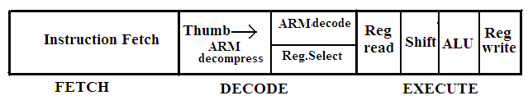
:
The ARM7TDMI-S processor has a Von Neumann architecture, with a single 32-bit data bus carrying both instructions and data.
Only load, store, and swap instructions can access data from memory.
The ARM7TDMI-S processor uses a three stage pipeline to increase the speed of the flow of instructions to the processor.
In the three-stage pipeline the instructions are executed in three stages.

Slide 6
ARM7TDMIS stands for
T: THUMB ;
D: for on-chip Debug support, enabling the processor to halt in response to a debug request,
M: enhanced Multiplier, yield a full 64-bit result, high performance
I: Embedded ICE hardware (In Circuit emulator)
S : Synthesizable

Slide 7
FEATURES:
A large uniform register file
A load/store architecture, where data-processing operations only operate on register contents, not directly on memory contents
Simple addressing modes, with all load/store addresses being determined from register contents and instruction fields only uniform and fixed-length instruction fields, to simplify instruction decode.
It Control over both the Arithmetic Logic Unit (ALU) and shifter in most data-processing instructions.
Auto-increment and auto-decrement addressing modes to optimize program loops
Load and Store Multiple instructions to maximize data.

Slide 8
3-Basic instruction set:
A 32- bit ARM instruction set
A 16 –bit Thumb instruction set and
The 8-bit Java Byte code used in Jazelle state
Thumb state is nearly 65% of the ARM code and can provide 160%of the performance of ARM code when working on a 16-bit memory system.

Slide 9
ARCHITECTURE OF ARM PROCESSORS
ARM uses AMBA and include two system buses: the AMBA High-Speed Bus (AHB) or the Advanced System Bus (ASB), and the Advanced Peripheral Bus (APB).
The ARM processor consists of
Arithmetic Logic Unit (32-bit)
One Booth multiplier(32-bit)
One Barrel shifter
One Control unit
Register file of 37 registers each of 32 bits.

Slide 10
:
Program status register of 32 bits
Priority encoder which is used in the multiple load and store instruction
Special registers like the instruction register, memory data read and write register and memory address register

Slide 11
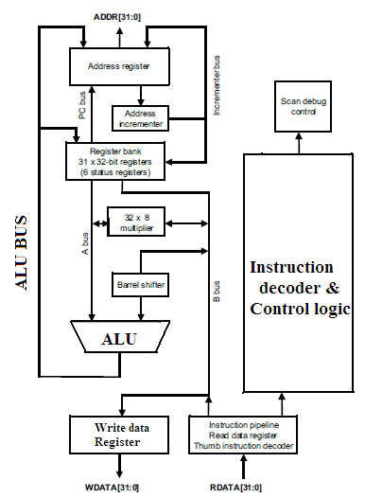
De-modulation

Slide 12
ARM registers
ARM has a total of 37 registers
31 are general-purpose registers of 32-bits, and six status registers .
only 16 registers are available to the users.
15 registers are used to speed up exception processing.
Two program status registers: CPSR and SPSR (the current and saved program status registers, respectively

Slide 13
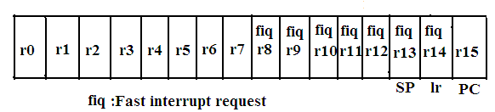
In ARM state the registers r0 to r13 are orthogonal—any instruction that you can apply to r0 you can equally well apply to any of the other registers.
In addition to this register bank ,there is also one 32-bit Current Program status Register(CPSR)

Slide 14
In the 15 registers ,the r13 acts as a stack pointer register and r14 acts as a link register and r15 acts as a program counter register.
Register 14 is the Link Register (LR). This register holds the address of the next instruction after a Branch and Link (BL or BLX) instruction, which is the instruction used to make a subroutine call

Slide 15
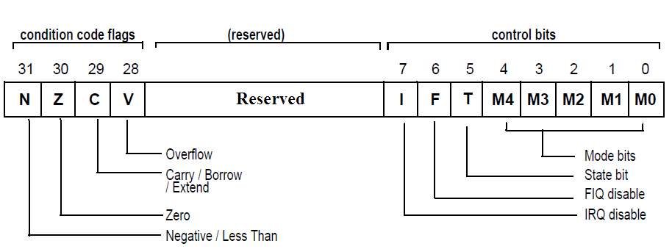

Slide 16
Processor modes
seven processor modes
Six privileged modes abort, fast interrupt request, interrupt request, supervisor, system, and undefined
one non-privileged mode called user mode.
The processor enters abort mode when there is a failed attempt to access memory
Supervisor mode is the mode that the processor is in after reset .
System mode is a special version of user mode that allows full read-write access to the CPSR.
Undefined mode is used when the processor encounters an instruction that is undefined or not supported by the implementation
User mode is used for programs and applications.

Slide 17
Banked registers
32 registers
20 registers are hidden from a program at different times. These registers are called banked registers
for example, abort mode has banked registers r13_abt , r14_abt and spsr _abt.
T=1 the processor is in thumb state.
T=o the processor is in ARM state and execute ARM instructions.

Slide 18
V, C , Z , N are the Condition flags .
V (oVerflow) : Set if the result causes a signed overflow
C (Carry) : Is set when the result causes an unsigned carry
Z (Zero) : This bit is set when the result after an arithmetic operation is zero, frequently used to indicate equality
N (Negative) : This bit is set when the bit 31 of the result is a binary 1.

Slide 19
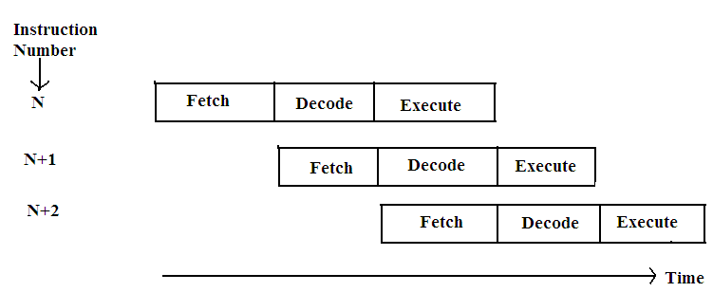
Pipeline
It used by the RISC processor to execute instructions at an increased speed.
This pipeline speeds up execution by fetching the next instruction while other instructions are being decoded and executed.
The ARM7 processor has a three stage pipelining architecture namely Fetch , Decode and Execute.
ARM 9 has five stage Pipe line architecture.

Slide 20
Example
let us consider that there are three instructions Compare, Subtract and Add.
The ARM7 processor fetches the first instruction CMP in the first cycle and during the second cycle it decodes the CMP instruction and at the same time it will fetch the SUB instruction.
During the third cycle it executes the CMP instruction , while decoding the SUB instruction and also at the same time will fetch the third instruction ADD. This will improve the speed of operation. This leads to the concept of parallel processing .
.

Slide 21
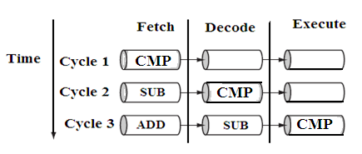
Table
:

Slide 22
Exceptions, Interrupts, and the Vector Table
The ARM architecture supports seven types of exceptions.
i.Reset
ii.Undefined Instruction
iii.Software Interrupt(SWI)
iv. Pre-fetch abort(Instruction Fetch memory fault)
v.Data abort (Data access memory fault)
vi. IRQ(normal Interrupt)
vii. FIQ (Fast Interrupt request).

Slide 23
Reset vector is the location of the first instruction executed by the processor when power is applied. This instruction branches to the initialization code.
Undefined instruction vector is used when the processor cannot decode an instruction.
Software interrupt vector is called when you execute a SWI instruction. The SWI instruction is frequently used as the mechanism to invoke an operating system routine.
Pre-fetch abort vector occurs when the processor attempts to fetch an instruction from an address
Data abort vector is similar to a prefetch abort but is raised when an instruction attempts to access data memory without the correct access permissions.
Interrupt request vector is used by external hardware to interrupt the normal execution flow of the processor
Output wave forms

Slide 24
Vector address
Excdption / Interrupt | Name | Address | High Address
Reset | RESET | 0X00000000 | 0Xffff0000
Undefined Instruction | UNDEF | 0X00000004 | 0Xffff0004
Software Interrupt | SWI | 0X00000008 | 0Xffff0008
Pre-fetch Abort | PABT | 0X0000000C | 0Xffff000c
Data Abort | DABT | 0X00000010 | 0Xffff0010
Reserved | --- | 0X00000014 | 0Xffff0014
Interrupt Request | IRQ | 0X00000018 | 0Xffff0018
Fast Interrupt Request | FIQ | 0X0000001C | 0Xffff001c

Slide 25
ARM families
ARM Family | Year of Release | Architecture | Pipeline | Operational Frequency | Multiplier | MIPS
ARM7 | 1995 | Von Neumann | 3 stage | 80 M.Hz | 8x32 | 0.97
ARM9 | 1997 | Harvard | 5 stage | 150M.Hz | 8x32 | 1.1
ARM10 | 1999 | Harvard | 6 stage | 260M.Hz | 16x32 | 1.3
ARM11 | 2003 | Harvard | 8 stage | 335M.Hz | 16x32 | 1.2

Slide 26
Instruction set
ARM instructions commonly take two or three operands.
For example ,the ADD instruction adds the two values stored in registers r1 and r2 (the source registers). It stores the result to register r3 (the destination register).
EX: ADD r3, r1, r2

Slide 29
ARM instructions are of five types
Data processing instructions,
Branch instructions,
load-store instructions,
Software interrupt instruction,
Program status register instructions.

Slide 30
DATA TRANSFER
The data processing instructions manipulate data within registers. They are move instructions, Arithmetic instructions, logical instructions, comparison instructions, and multiply instructions. Most data processing instructions can process one of their operands using the barrel shifter.
i)Move Instructions : Move instruction copies R into a destination register Rd, where R is a register or immediate value. This instruction is useful for setting initial values and transferring data between registers
Wave forms

Slide 31
Example1 : PRE r5 = 5
r7 = 8
MOV r7, r5 ;
POST r5 = 5
r7 = 5
The MOV instruction takes the contents of register r5 and copies them into register r7.
Example 2: MOVS r0, r1, LSL #1
MOVS instruction shifts register r1 left by one bit

Slide 32
Arithmetic Instructions : The arithmetic instructions implement addition and subtraction of 32-bit signed and unsigned values.
SUB r0, r1, r2 ; This subtract instruction subtracts a value stored in register r2 from a value stored in register r1. The result is stored in register r0.
RSB r0, r1, #0 ; This reverse subtract instruction (RSB) subtracts r1 from the constant value #0, writing. the result to r0. You can use this instruction to negate numbers.

Slide 34
Logical Instructions : These Logical instructions perform bitwise logical operations on the two source registers.

Slide 35
Comparison Instructions : The comparison instructions are used to compare (or) test a register with a 32-bit value. This instruction affects only CPSR register flags

Slide 36
Branch Instructions: A branch instruction changes the normal flow of execution of a main program or is used to call a subroutine routine. This type of instruction allows programs to have subroutines, if-then-else structures, and loops

Slide 37
Load-Store Instructions : Load-store instructions transfer data between memory and processor registers. There are three types of load-store instructions:
Single-register transfer
Multiple-register transfer, and
Swap.
Single-Register Transfer : These instructions are used for moving a single data item in and out of a register.
Ex1: STR r0, [r1] ; = STR r0, [r1, #0] ; store the contents of register r0 to the memory address pointed to by register r1.

Slide 39
Multiple-Register Transfer : Load-store multiple instructions can transfer multiple registers between memory and the processor in a single instruction. The transfer occurs from a base address register Rn pointing into memory,
Example 1: LDMIA r0!, {r1-r3} ; In this example, register r0 is the base register Rn and is followed by !, indicating that the register is updated after the instruction is executed. In this case the range is from register r1 to r3.
Example 2 : LDMIB : load multiple and increment before
Stack: A stack is either ascending (A) or descending (D). Ascending stacks grow towards higher memory addresses; in contrast, descending stacks which grow towards lower memory addresses. When a full stack (F)is used , the stack pointer sp points to an address that is the last used or full location (i.e., sp points to the last item on the stack).

Slide 40
Example1 : The STMFD instruction pushes registers onto the stack, updating the sp.
STMFD sp! , {r1,r4}; Store Multiple Full Descending Stack
PRE r1 = 0x00000002
r4 = 0x00000003
sp = 0x00080014
POST r1 = 0x00000002
r4 = 0x00000003
sp = 0x0008000c.
The stack operation is shown by the following diagram.

Slide 41
Swap Instruction :
The Swap instruction is a special case of a load-store instruction. It swaps (Similar to exchange) the contents of memory with the contents of a register. This instruction is an atomic operation—it reads and writes a location in the same bus operation, preventing any other instruction from reading or writing to that location until it completes. Swap cannot be interrupted by any other instruction or any other bus access. So, the system “holds the bus” until the transaction is complete.
Ex 1: SWP : Swap a word between memory and a register tmp = mem32[Rn]
mem32[Rn] =Rm
Rd = tmp
Ex2 : SWPB Swap a byte between memory and a register tmp = mem8[Rn]
mem8[Rn] =Rm

Slide 42
Introduction to Thumb instruction set :
Thumb encodes a subset of the 32-bit ARM instructions into a 16-bit instruction set space.
Thumb has higher performance than ARM on a processor with a 16-bit data bus, but lower performance than ARM on a 32-bit data bus, use Thumb for memory-constrained systems
Thumb has higher code density—the space taken up in memory execute program—than ARM
For memory-constrained embedded systems,
Example:, mobile phones and PDAs, code density is very important.
Cost pressures also limit memory size, width, and speed.

Slide 43
Thumb execution is flagged by the T bit (bit [5] ) in the CPSR
Thumb implementation of the same code takes up around 30% less memory than the equivalent ARM implementation
Thumb implementation uses more instructions ; the overall memory footprint is reduced.
Code density was the main driving force for the Thumb instruction set
It also designed as a compiler target, rather than for hand-written assembly code

Slide 44
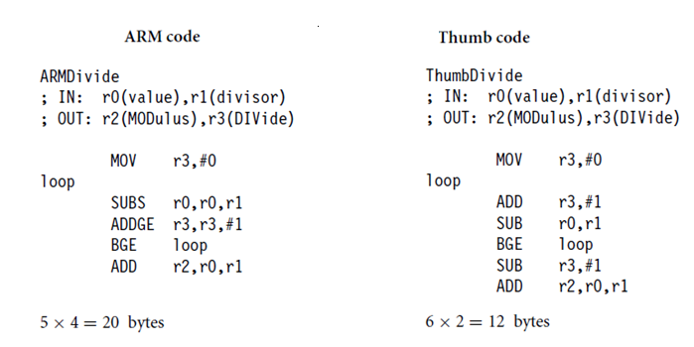
Thumb code is more denser than the ARM code.

Slide 45
Exceptions generated during Thumb execution switch to ARM execution before executing the exception handler . The state of the T bit is preserved in the SPSR, and the LR of the exception mode is set so that the normal return instruction performs correctly, regardless of whether the exception occurred during ARM or Thumb execution
In Thumb state, all the registers can not be accessed . Only the low registers r0 to r7 can be accessed. The higher registers r8 to r12 are only accessible with MOV, ADD, or CMP instructions.

Slide 46
S.No | Registers | Access
1 | r0 – r7 | Fully accessible
2 | r8 – r12 | Only accessible by MOV ,ADD &CMP
3 | r13SP | Limited accessibility
4 | r14 lr | Limited accessibility
5 | r15 PC | Limited accessibility
6 | CPSR | Only indirect access
7 | SPSR | No access

Slide 47
It is clear that there are no MSR and MRS equivalent Thumb instructions. To alter the CPSR or SPSR , one must switch into ARM state to use MSR and MRS. Similarly, there are no coprocessor instructions in Thumb state. You need to be in ARM state to access the coprocessor for configuring cache and memory management.
ARM-Thumb interworking is the method of linking ARM and Thumb code together for both assembly and C/C++.
It handles the transition between the two states. To call a Thumb routine from an ARM routine, the core has to change state. This is done with the T bit of CPSR .
The BX and BLX branch instructions cause a switch between ARM and Thumb state while branching to a routine.

Slide 48
The data processing instructions manipulate data within registers.
They include move instructions, arithmetic instructions, shifts, logical instructions, comparison instructions, and multiply instructions.
The Thumb data processing instructions are a subset of the ARM data processing instructions

Slide 49
: ADC : add two 32-bit values and carry Rd = Rd + Rm + C flag
ADD : add two 32-bit values Rd = Rn + immediate
Rd = Rd + immediate
Rd = Rd + Rm
AND : logical bitwise AND of two 32-bit values Rd = Rd & Rm
ASR : arithmetic shift right Rd = Rm_immediate,
C flag= Rm[immediate − 1]
Rd = Rd_Rs, C flag = Rd[Rs - 1]
BIC : logical bit clear (AND NOT) of two 32-bit Rd = Rd AND
NOT(Rm)values
CMN : compare negative two 32-bit values Rn + Rm sets flags
CMP : compare two 32-bit integers Rn−immediate sets flags Rn−Rm sets flags
EOR : logical exclusive OR of two 32-bit values Rd = Rd EOR Rm
LSL : logical shift left Rd = Rm_ immediate,
C flag= Rm[32 − immediate]
Rd = Rd_Rs, C flag = Rd[32 − Rs]
LSR : logical shift right Rd = Rm_ immediate,
C flag = Rd [immediate − 1]
Rd = Rd_ Rs, C flag = Rd[Rs − 1]
MOV : move a 32-bit value into a register Rd = immediate

Slide 50
Rd = Rn
Rd = Rm
MUL : multiply two 32-bit values Rd = (Rm * Rd)[31:0]
MVN : move the logical NOT of a 32-bit value into a register Rd = NOT(Rm)
NEG : negate a 32-bit value Rd = 0 − Rm
ORR : logical bitwise OR of two 32-bit values Rd = Rd OR Rm
ROR : rotate right a 32-bit value Rd = Rd RIGHT_ROTATE Rs,
C flag= Rd[Rs−1]
SBC : subtract with carry a 32-bit value Rd = Rd − Rm − NOT(C flag)
SUB : subtract two 32-bit values Rd = Rn − immediate
Rd = Rd − immediate
Rd = Rn − Rm
sp = sp − (immediate_2)
TST : test bits of a 32-bit value Rn AND Rm sets flags
Note : Thumb deviates from the ARM style in that the barrel shift operations (ASR, LSL, LSR,
and ROR) are separate instructions.

Slide 51
THANK U

