Slide 1
Unit I
Introduction
to
Human Resource Management

Slide 2
Human beings are social beings and hardly ever live and work in isolation.
From childhood each and every individual acquire knowledge and experience on understanding others and how to behave in each and every situations in life. Later we carry forward this learning and understanding in carrying and managing relations at our workplace.
The whole context of Human Resource Management revolves around this core matter of managing relations at work place.

Slide 3
Since mid 1980’s Human Resource Management (HRM) has gained acceptance in both academic and commercial circle.
HRM is a multidisciplinary organizational function that draws theories and ideas from various fields such as management, psychology, sociology and economics.
As we know that the principal resources of an organization is the people. Without which no organization can born and run.
HRM is the study of activities regarding people working in an organization. It is a managerial function that tries to match an organization’s needs to the skills and abilities of its employees.

Slide 4
“Human resources are ―a whole consisting of inter -related, inter-dependent and interacting -physiological, psychological, sociological and ethical components.” Michael J. Jucius
Megginson has defined human resources as “From the national point of view, human resources are knowledge, skills, creative abilities, talents and attitudes obtained in the population; whereas from the viewpoint of the individual enterprise they represent the total of the inherent abilities, acquired knowledge and skills, talents and aptitudes of its employers”

Slide 5
Human Resource Management (HRM) is that part of management process which develops and manages the human element of the enterprise considering their resourcefulness in terms of total knowledge, skills, creative abilities, talents, aptitudes and potentialities for effectively contributing to the organizational objectives.

Slide 6
Sumantra Ghosal considers human resources as human capital. He classifies human capital into three categories – intellectual capital, social capital and emotional capital. Intellectual capital consists of specialized knowledge, tacit knowledge and skills, cognitive complexity and learning capacity. Social capital is made up of network of relationships, sociability, and trustworthiness. Emotional capital consists of self- confidence, ambition and courage, risk-bearing ability and resilience” (the capacity to recover quickly from difficulties)

Slide 7
Definition of HRM
According to, Edwin B Flippo
“Human resource management is the planning , organizing , directing and controlling of the procurement, development, compensation, integration, maintenance, and separation of human resource to the end that individual, organizational and social objectives are accomplished.”

Slide 8
According to Decenzo and Robbins, “HRM is concerned with the people dimension” in management. Since every organization is made up of people, acquiring their services, developing their skills, motivating them to higher levels of performance and ensuring that they continue to maintain their commitment to the organization is essential to achieve organisational objectives. This is true, regardless of the type of organization – government, business, education, health or social action”.

Slide 9
Characteristics of HRM:
Action Oriented
Human Approach
Part of Management
Pervasive function
Result Oriented.
Integrative Action
Continuous Process
Basic to all Functional Areas
People-Centric

Slide 10
Based on Human Relations
Comprehensive Function
Interdisciplinary Function
Tactful Approach
Importance of Human Resource Management
Employing right kind of employees in Right positions and at Right time
Attracting and retaining the best talent
Developing skill and attitude

Slide 11
Enhance the Quality of Work Life
Redressing Grievance and Conflict.
Achieving Organizational Goals
Team Spirit and Feeling of belongingness
Employee Satisfaction and Welfare
Fair and Adequate and Equitable wages and salaries
Improve motivation and morale
Ensures job satisfaction

Slide 12
Improves living standards
Initiates social security
Develops employees to meet challenges of their future jobs
Good human relations, social relations, Industrial relations
Minimizes absenteeism and labor turn over
Promotes industrial peace
Image of the organization

Slide 13
Securing employee willing of co-operation
Optimum utilization of resources

Slide 14
SCOPE OF HRM
The scope of HRM is extensive and far-reaching. Therefore, it is very difficult to define it concisely. However, we may classify the same under following heads:
HRM in Personnel Management: (Personnel Aspects)
This is typically direct manpower management that involves manpower planning, hiring (recruitment and selection), training and development, induction and orientation, transfer, promotion, compensation, layoff and retrenchment, employee productivity. The overall objective here is to ascertain individual growth, development and effectiveness which indirectly contribute to organizational development. It also includes performance appraisal, developing new skills, disbursement of wages, incentives, allowances, traveling policies and procedures and other related courses of actions.

Slide 15
HRM in Employee Welfare (Welfare Aspects)
This particular aspect of HRM deals with working conditions and amenities at workplace. This includes a wide array of responsibilities and services such as safety services, health services, welfare funds, social security and medical services. It also covers appointment of safety officers, making the environment worth working, eliminating workplace hazards, support by top management, job safety, cleanliness, proper ventilation and lighting, sanitation, medical care, sickness benefits, employment injury benefits, personal injury benefits, maternity benefits, unemployment benefits and family benefits.

Slide 16
It also relates to supervision, employee counselling, establishing harmonious relationships with employees, education and training.
Employee welfare is about determining employees’ real needs and fulfilling them with active participation of both management and employees. In addition to this, it also takes care of canteen facilities, crèches, rest and lunch rooms, housing, transport, medical assistance, education, health and safety, recreation facilities, etc.

Slide 17
HRM in Industrial Relations:( Industrial Relations Aspects)
Since it is a highly sensitive area, it needs careful interactions with labour or employee unions, addressing their grievances and settling the disputes effectively in order to maintain peace and harmony in the organization. It is the art and science of understanding the employment (union-management) relations, joint consultation, disciplinary procedures, solving problems with mutual efforts, understanding human behaviour and maintaining work relations, collective bargaining and settlement of disputes. The main aim is to safeguarding the interest of employees by securing the highest level of understanding to the extent that does not leave a negative impact on organization. It is about establishing, growing and promoting industrial democracy to safeguard the interests of both employees and management

Slide 18
The Indian Institute of Personnel Management (IIPM) has mentioned the scope of HRM as
Personnel or Labour Aspect
The first aspect deals with manpower planning, recruitment, selection, placement, transfer, promotion, training and development, lay-offs and retrenchment, remuneration, incentives and productivity
Welfare Aspect
This aspect is concerned with the working conditions and with amenities such as canteen, crèches, rest- and lunch- rooms, housing, transport, medical assistance, education, health and safety, and recreation facilities.
Industrial Relations Aspect
This aspect pertains to union management relations, joint consultations, collective bargaining, grievance and disciplinary actions, and settlement of disputes

Slide 19
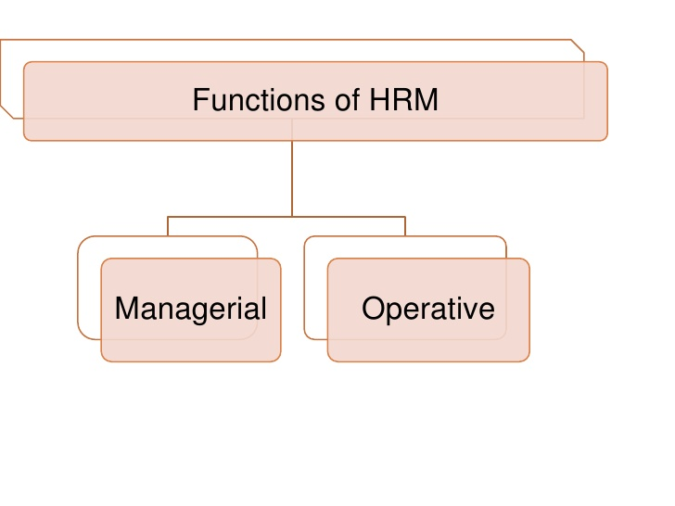

Slide 20
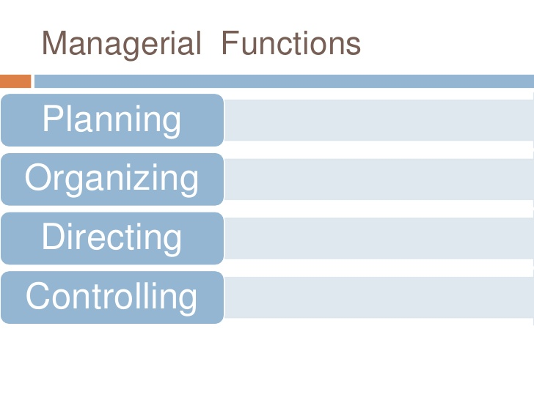

Slide 21
(1) Managerial Functions:
Planning:
Planning is a predetermined course of actions. It is a process of determining the organizational goals and formulation of policies and programmes for achieving them. Thus planning is future oriented concerned with clearly charting out the desired direction of business activities in future. Forecasting is one of the important elements in the planning process. Other functions of managers depend on planning function.
With respect to the human resource department, planning involves determining the personnel programs that can contribute to achieving the organization’s goals.
These programs include anticipating the hiring needs of the organization, planning job requirements, descriptions, and determining the sources of recruitment.

Slide 22
Organizing:
Organizing is a process by which the structure and allocation of jobs are determined. Thus organizing involves giving each subordinate a specific task establishing departments, delegating authority to subordinates, establishing channels of authority and communication, coordinating the work of subordinates, and so on
In an organization tasks are allocated among its members, relationships are identified, and activities are integrated towards a common objective. Relationships are established among the employees so that they can collectively contribute to the attainment of organization goal

Slide 23
Directing - Activating employees at different level and making them contribute maximum to the organization is possible through proper direction and motivation. Taping the maximum potentialities of the employees is possible through motivation and command.
The HR Manager can create plans, but implementing the plans smoothly depends on how motivated the people are. The directing functions of HRM involve encouraging people to work willingly and efficiently to achieve the goals of the organization through guiding, leading, communicating and motivating people to accomplish the personnel programs.

Slide 24
Controlling - After planning, organizing, and directing, the actual performance of employees is checked, verified, and compared with the plans. If the actual performance is found deviated from the plan, control measures are required to be taken.
Controlling is a very important function of management. In an undertaking, control consists in verifying whether everything occurs in conformity with the plan adopted, the instructions issued and the principles laid down. In this way, controlling is a measuring and corrective device.

Slide 25
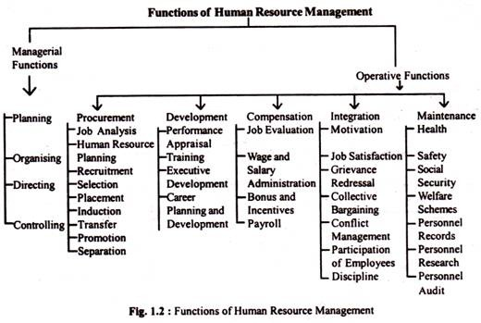

Slide 26
Procurement:
The first important function of HRM is securing and employing the right type of personnel according to the needs or requirements of the organization. For effective performance of procurement function, HRM has to perform a number of functions such as
Job Analysis and Design - Job analysis is the process of describing the nature of a job and specifying the human requirements like qualification, skills, and work experience to perform that job. Job design aims at outlining and organizing tasks, duties, and responsibilities into a single unit of work for the achievement of certain objectives.

Slide 27
Development:
This function involves activities meant to improve the knowledge, skills aptitudes and values of employees so as to enable them to perform their jobs in a better manner in future. These functions may comprise training to employees, executive training to develop managers, organization development to strike a better fit between organizational climate/culture and employees
This function of human resource management helps the employees to acquire skills and knowledge to perform their jobs effectively. Training an development programs are organized for both new and existing employees. Employees are prepared for higher level responsibilities through training and development

Slide 28
Compensation:
Compensation function involves determination of wages and salaries matching with contribution made by employees to organizational goals. In other words, this function ensures equitable and fair remuneration for employees in the organization. It consists of activities such as job evaluation, wage and salary administration, bonus, incentives, etc.

Slide 29
The integration function of HRM is the process of reconciling organizational goals. Integration Function of HRM combines all the activities related to managing employees within a company. So that they can work willingly and effectively for the best results.
Integration involves motivating employees through. various financial and non financial incentives providing satisfaction, handling employees grievances through formal grievance Procedure , collective bargaining, workers participation etc.aspects.

Slide 30
Maintenance:
Maintenance function of human resource management is concerned with protecting and promoting the physical and mental health of employees. In order to achieve these objective several types of fringe-benefits must be provided.
It is concerned with protecting and promoting employees while at work. For this purpose various benefits such as housing, medical, educational, transport facilities, etc. are provided to the employees. Several social security measures such as provident fund, pension, gratuity, group insurance, etc. are also arranged.

Slide 31
Role of Human Resource Manager in an Organization
HR Manager plays a crucial role in the process of converting inputs into outputs, product design, quality maintenance, rendering services and many other functions depend largely on the human efficiency. His/ Her roles include Advisory Role, Counselor Role, Mediator Role, Spokesman Role, Role of Change Agent, Welfare Role, Strategist Role, Coordinator’s Role, Facilitator Role, Fire-fighting/Legal Role,Decision-making Role , Executive Role etc.

Slide 32
1. Advisory Role:
One of the major roles of HR manager is, to advise the top management in the matter relating to management and development of human resource, in order to achieve organizational objects. Looking to the company’s vision, mission and long range planning, HR executive advises the higher management to formulate appropriate HR policies, procedures which may create a perceptible change in the minds of the people
2. Counselor Role:
An important role of the HR manager is that of a counselor. Whenever an employee is dissatisfied with the job he approaches the HR manager for counseling and guidance.

Slide 33
An employee can also approach the HR manager for counselling for other problems related to his/her personal life which is likely to influence his performance like, health, children education or marriage, mental and physical problems etc. The HR manager listens to their problems and offers suggestions to solve those problems.
3. Mediator Role:
In any organization, there are times when there are differences of opinion and misunderstan­ding between the management and the employee or between employees themselves. Here, HR manager acts as a mediator, a peace-maker and a communication link between them.

Slide 34
4. Spokesman Role:
HR manager acts as a spokes person within the company, as well as are representative of the company. HR executive works as a spokesperson of the company especially, in the matter of depicting organization health, condition, strength etc. to the employees while negotiating for settlement of industrial disputes. He also acts as a representative of the workers when they are non-unionized/unorganized
5.Role of Change Agent – To convince workers and the management and take the lead in implementing changes in technology, organization, production and installing the organization development techniques etc.

Slide 35
6. Problem Solver Role :
HR manager acts as a problem solver with respect to the issues that involve human resources management and over all long range organizational planning.
7.Welfare Role:
HR executive looks to the welfare aspect of the employee’s viz., canteen, crèches, rest-rooms, hospital, transportation, housing accommodation, school, etc. His one of the principal roles is to provide welfare facilities to the employees of the organisation.

Slide 36
8.Strategist Role:
HR manager helps to accomplish business strategy of the organization through introducing and implementing HR strategies.
9.Coordinator Role:
HR executive coordinates the task of developing, interpreting of HR programmes, policies which are put into operation by the line people, and develops a team spirit amongst them.

Slide 37
10.Facilitator Role:
A large number of organizational activities require a Human Resource professional to play the role of a facilitator. For example, Human Resource manager acts as a facilitator when training and development activities are planned and conducted and performance appraisals are done.
11.Fire-fighting/Legal Role :
Grievance handling, settlement of disputes, handling disciplinary cases, collective bargaining, joint consultation, interpretation and implementation of various labour laws, contacting lawyers, handling industrial tribunals etc.

Slide 38
12.Decision-making Role :
To play a dominant role in the decision-making process, regarding both major and minor issues of the organization involving human resources.
13.Executive Role : Once decisions are taken HR manager plays a dominant role in executing those decisions and programmes.

Slide 39
14.Innovator Role :
HR professionals should have a strong acumen for creativity and innovation, so as to effectively introduce new processes and procedures which would contribute to enhance organizational effectiveness.
15.Liaison Officer/Linking Pin:
The HR manager is often deputed to act as a linking pin between the various divisions/departments of an organization. He acts as a liaison officer in that capacity his function is to act as a contact for external agencies. The whole exercise is meant to develop rapport with divisional heads, using PR and communication skills of HR executives to the maximum possible extent

Slide 40
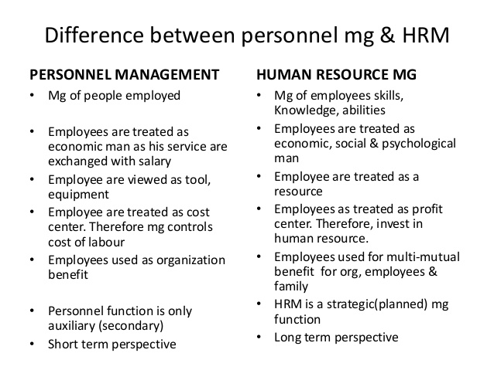

Slide 41
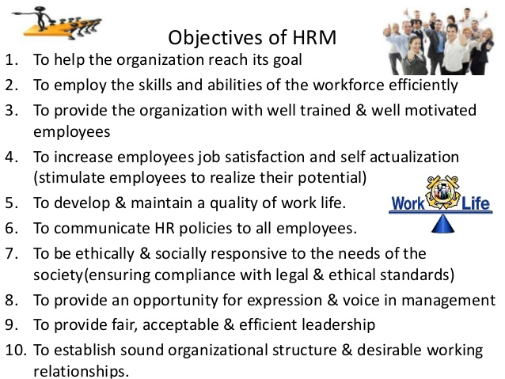

Slide 42
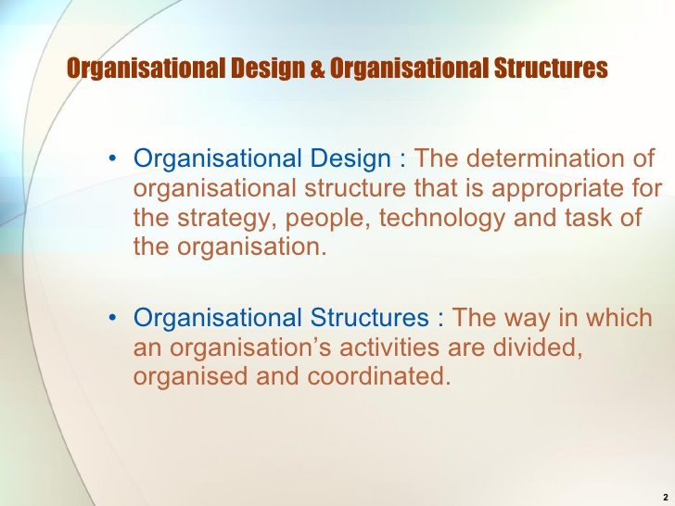

Slide 43
Organizing: After the human resource manager establishes the objectives and develops plans and programs to achieve them, he needs to design and develop the organization's structure to carry out the different operations.
Grouping of personnel activity into functions or positions
Assigning different groups of activities to different individuals
Delegating authority according to the tasks assigned and responsibilities involved
Coordinating activities of different employees

Slide 44
Organizing is the function of management that involves developing an organizational structure and allocating human resources to ensure the accomplishment of objectives. The structure of the organization is the framework within which effort is coordinated. The structure is usually represented by an organization chart, which provides a graphic representation of the chain of command within an organization. Decisions made about the structure of an organization are generally referred to as organizational design decisions

Slide 45
Organizing also involves the design of individual jobs within the organization. Decisions must be made about the duties and responsibilities of individual jobs, as well as the manner in which the duties should be carried out. Decisions made about the nature of jobs within the organization are generally called “job design” decisions.
Organizing at the level of the organization involves deciding how best to departmentalize, or cluster, jobs into departments to coordinate effort effectively. There are many different ways to departmentalize, including organizing by function, product, geography, or customer. Many larger organizations use multiple methods of departmentalization.

Slide 46
Organizing at the level of a particular job involves how best to design individual jobs to most effectively use human resources. Traditionally, job design was based on principles of division of labor and specialization, which assumed that the more narrow the job content, the more proficient the individual performing the job could become.
Recently, many organizations have attempted to strike a balance between the need for worker specialization and the need for workers to have jobs that entail variety and autonomy. Many jobs are now designed based on such principles as empowerment, job enrichment and teamwork.

Slide 47
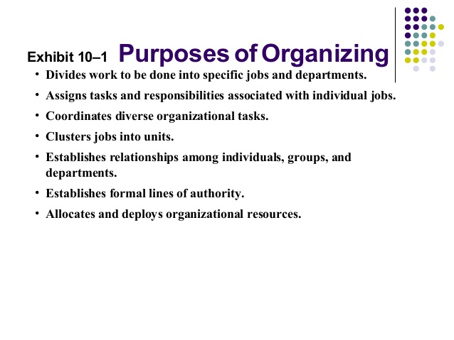

Slide 48
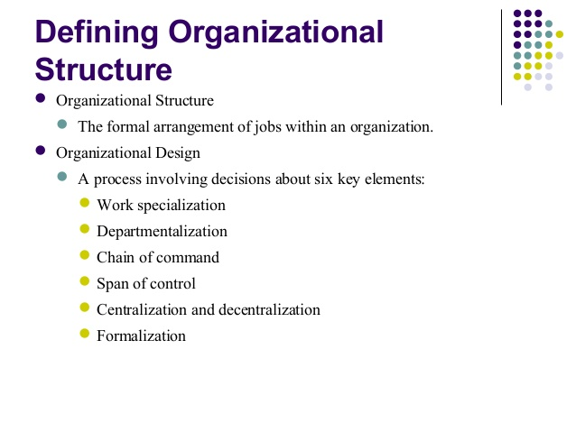

Slide 49
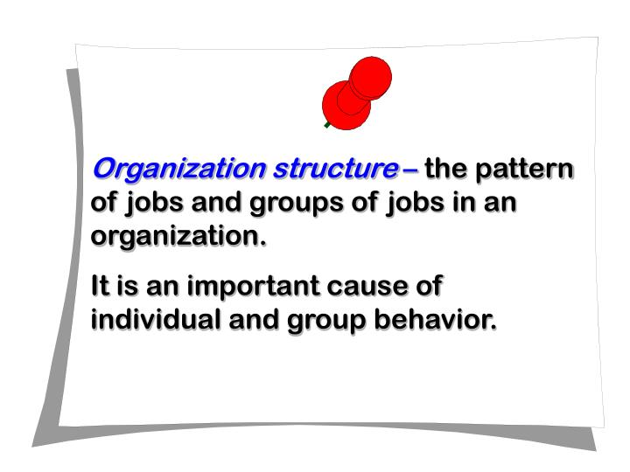

Slide 50
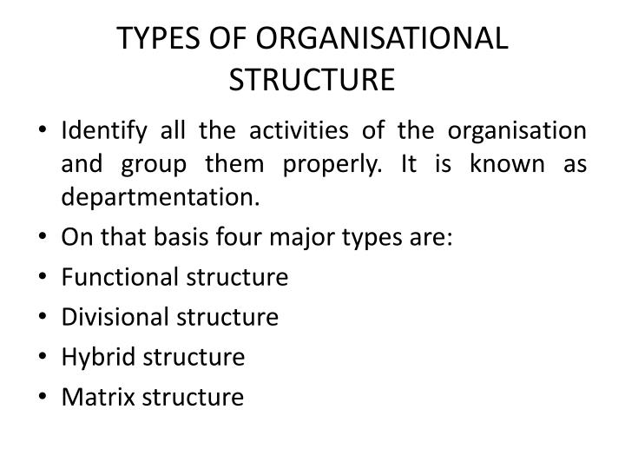

Slide 51
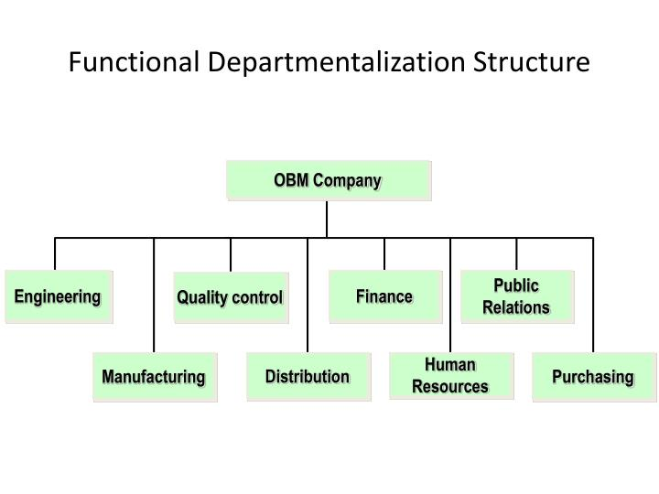

Slide 52
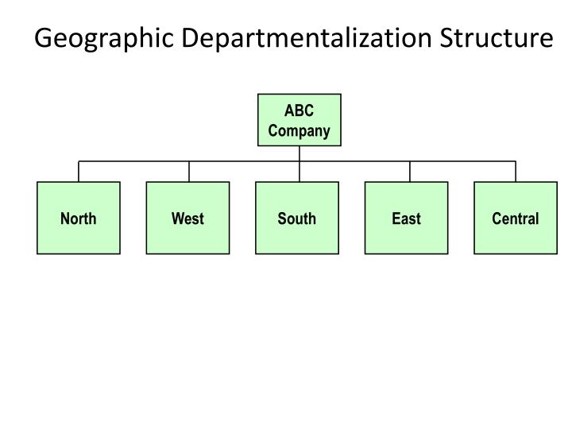

Slide 53
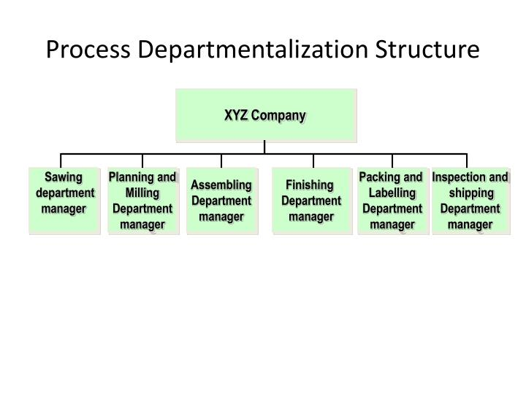

Slide 54


Slide 55
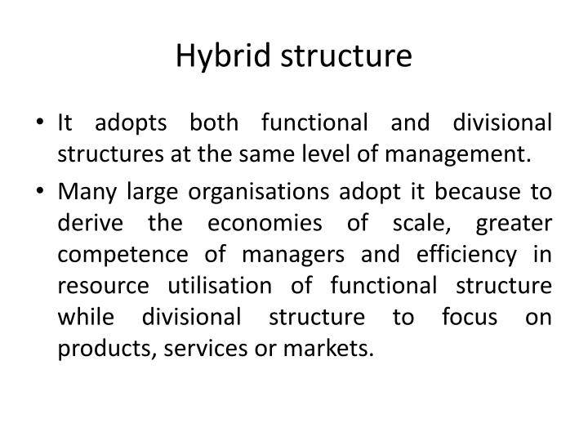

Slide 56
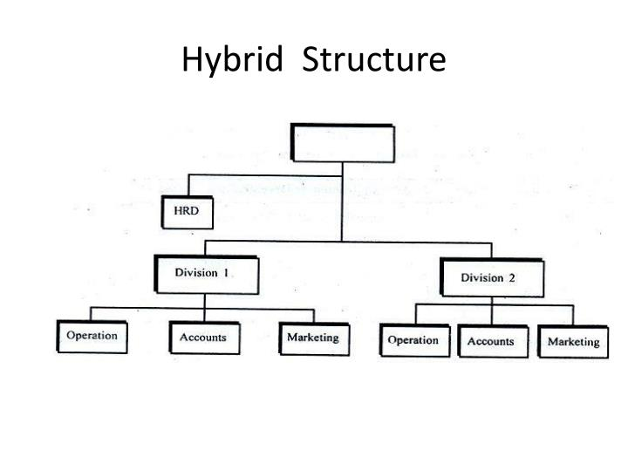

Slide 57
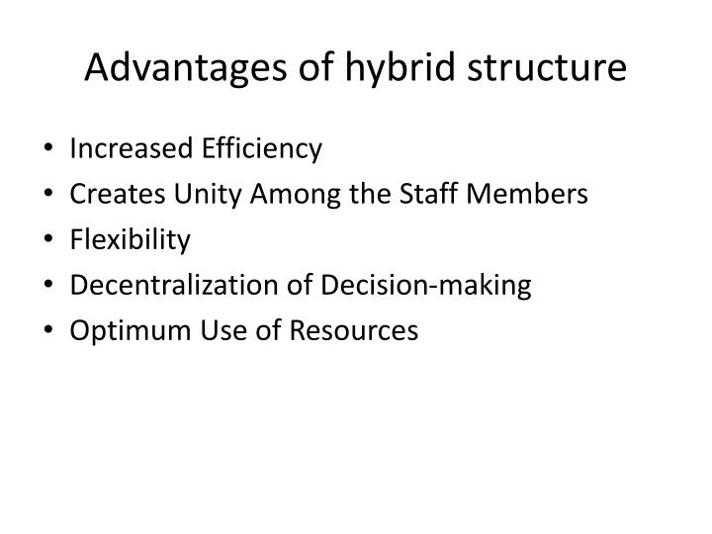

Slide 58
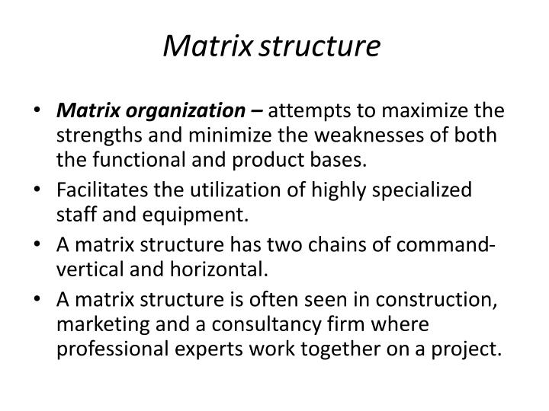

Slide 59
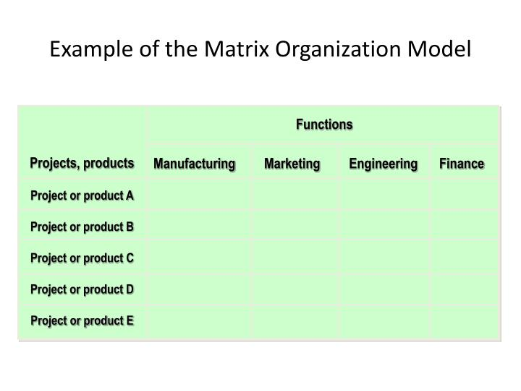

Slide 60
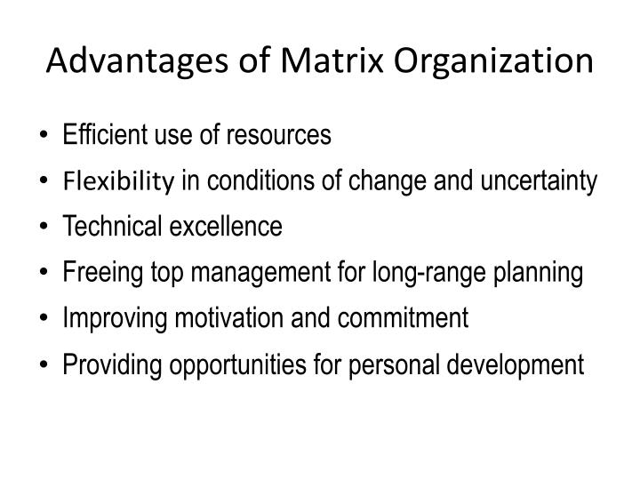

Slide 61
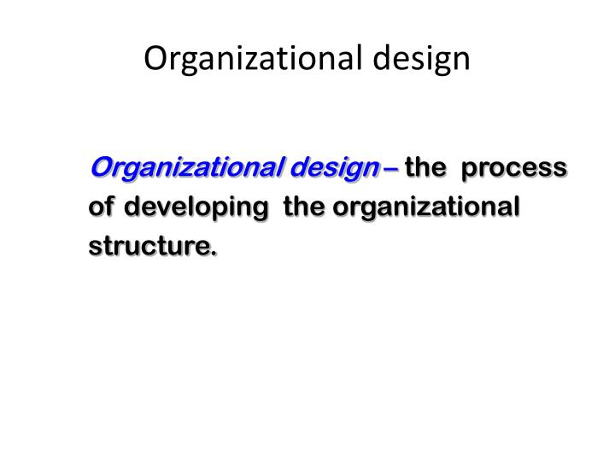

Slide 62
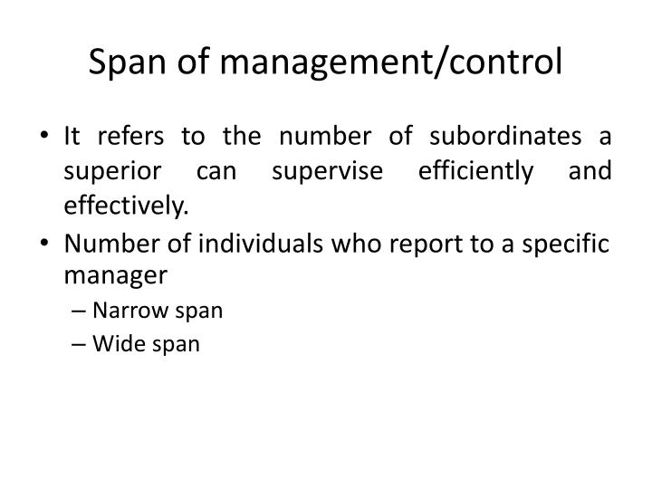

Slide 63
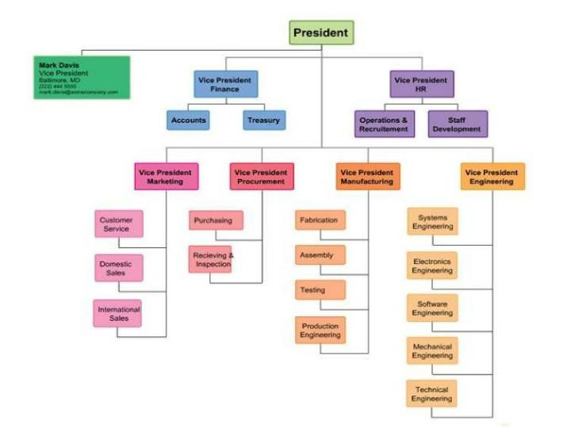

Slide 64
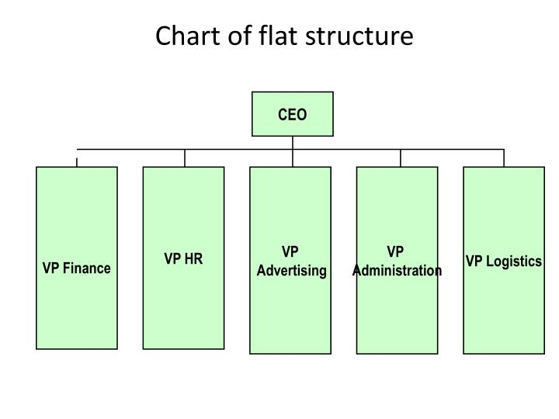

Slide 65
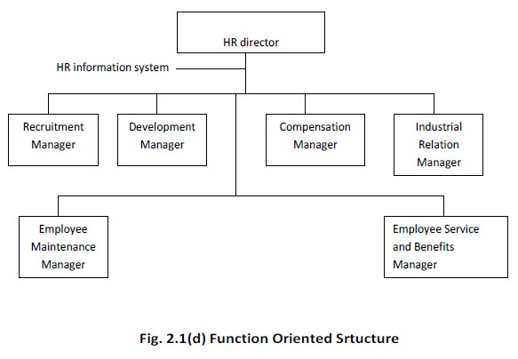

Slide 66
Human Resource Management Models
They provide an analytical framework for studying Human resource management
They legitimize certain HRM practices; a key issue here is the distinctiveness of HRM practices: “
They provide a characterization of human resource management that establishes variables and relationships to be researched.
They serve as a heuristic device- to help us discover and understand the nature and significance of key HR practices.

Slide 67
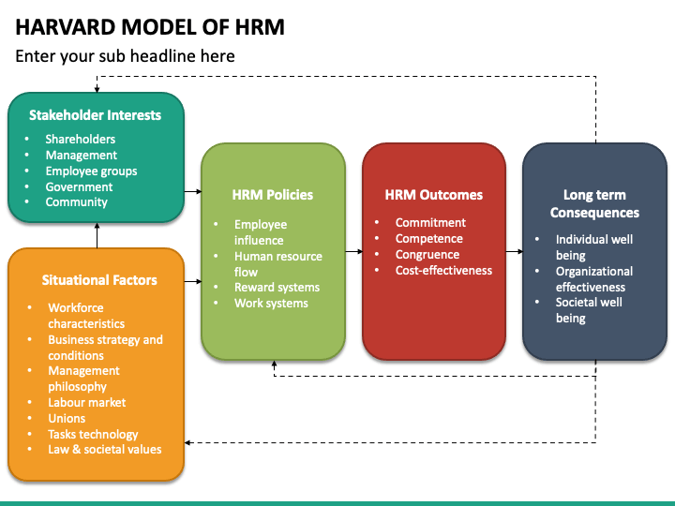

Slide 68
The Harvard Model
The Harvard model claims to be comprehensive in as much as it seeks to comprise six critical components of HRM. The dimensions included in the model are stakeholders interests, situational factors, HRM policy choices, HR outcomes, long-term consequences, and a feedback loop through. The outputs flow directly into the organization and the stakeholders
Harvard model is based upon situational factors and stakeholder interests
Situational factors are not within the organization’s control, such as, legal, environmental and trade unions
Stakeholder interests are factors which are influenced by any person or body with a vested interest in the organization

Slide 69
The managers can affect a number of factors by means of the policy choices they make
The 4 C’s of this model are listed below:
Commitment
Competence
Costs effectiveness
Congruence

Slide 70
Commitment of employees to an organization will lead to better loyalty and improved performance
Competence is the skill and knowledge of the employee, highly skilled & knowledgeable employee should be retained & developed
Cost effectiveness has impact on salaries, benefits, and the reward system
Congruence is the quality of agreement between the employees and the organization’s goals

Slide 71
Ten C’s model of HRM
Ten C’s model of HRM is regarded as all-encompassing and a pragmatic model. Alan Price is the architect of this model who presented it in his book titled Human Resource Management in a Business Context, published in 1997. There are ten essential principles-the Ten Cs-in this model. These are: Comprehensiveness Credibility Communication Cost effectiveness Creativity
Coherence Competence Control Change.
Commitment

Slide 72
1.Comprehensiveness | 2.Credibility
3.Communication | 4.Cost effectiveness
5.Creativity | 6.Coherence
7.Competence | 8.Control
9.Change. | 10.Commitment

Slide 73
1. Comprehensiveness. The HRM strategy of an organization must include all the aspects of people management, typically starting from recruitment to post separation programmes. 2. Credibility. The HR practices must build trust between staff and top management and encourage employees’ belief in HRM strategies. 3. Communication. The objectives of organization and that of HRM must be understood and accepted by all employees. The operating culture in organization must encourage openness and be free from all barriers.

Slide 74
4. Cost effectiveness. The reward and promotion system must be fair.
5. Creativity. The competitive advantage of the company must stem from its unique HR strategies. 6. Coherence. HRM activities and initiatives must from a meaningful whole.(unified or consistency)
7. Competence. HRM strategy will be crafted in such a way that organization becomes competent to achieve its objectives with the support of individual competencies.

Slide 75
8. Control. HRM policies and practices must ensure that performance of HR is consistent with business objectives. 9. Change. The basic premise of HRM strategy must be that continuous improvement and development is essential for survival. 10. Commitment. The last ‘C’ Stresses upon that employee are to be motivated to achieve organizational goals.

Slide 76
The Ulrich Model
The Ulrich Model (or the Business Partner Model) was first introduced in 1995 by Dave Ulrich, “the father of modern HR.” In his book “Human Resource Champions”, published in 1997, Ulrich elaborated the idea further.
The Ulrich Model falls under the creative HRM and focuses on organizing all HR functions into four central roles: strategic partner, change agent, administrative expert, and employee champion (or employee advocate). Rather than focusing on processes and functions, this model is centered around people of the organization and the roles they play in the grand scheme of things.

Slide 77
Fombrun’s human resource cycle model (1984)
The Michigan model by Fombrun (1984) explains strategic HRM that focused on management, professional groups, and the new labor force. The main motive of the model was to align the formal structure of the organization, their new strategies, and policies with the human resource system. This helps to drive the strategic objectives of the organization in a better way. They saw the employees of the firm as a strategic resource to have a competitive advantage. Its elements include selection, appraisal, development, and rewards.

Slide 78
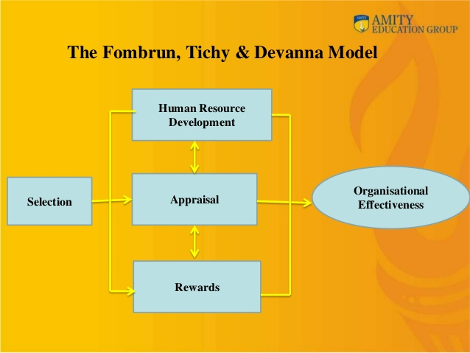

Slide 79
Guest’s model of HRM
This model was developed by David Guest in 1997. It explains how HRM is different from personnel management (Morrow, 2000). It works on the assumption that the human resource manager begins with certain strategies, which will result in outcomes. The model integrates HRM practices leading to superior individual and organizational performance
It has six dimensions of analysis:
Strategy,
Practices,
Outcomes,
Behavior outcomes,
Performance outcomes and,
Financial outcomes.

Slide 80
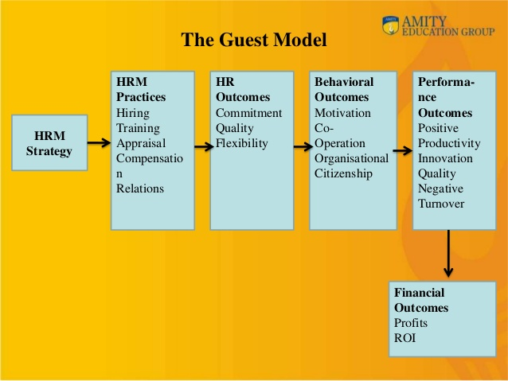

Slide 81
Best HRM practices model
The best practice model is one that can be applied universally (Johnson, 2000). For the best fit, human resource policies must be aligned with business strategy and objectives. This can be done by checking regularly on the needs of the organization as well as employees. The best practice leads to superior business employees. These processes help the organization to have a comparative advantage. There are various practices that are universal in nature and adopting them leads to the superior performance of the organization. These are:

Slide 82
Employment security,
Selective hiring,
High compensation based on performance,
Self-managed teams,
Training to have skilled workers,
Equality among workers,
Sharing essential information with the employees of the firm.

Slide 83
HRM in a Changing Environment: The Challenges
Today's organizations are facing challenges upon following levels:
Environmental Challenges
Organizational Challenges
Individual Challenges

Slide 84
Environmental Challenges:
The environmental challenges are related to the external forces that exist in the outside environment of an organization & can influence the performance of the management of the organization. These external forces are almost out of control of the management of the organization. These can be regarded as threats to management & should be handled in a proactive manner.

Slide 85
HRM challenges that considered as the environmental challenges are:
Rapid Change
Work Force Diversity
Globalization
Legislation
Technology
Evolving Work and Family Roles
Skill Shortages and the Rise of the Service Sector.

Slide 86
Organizational Challenges
The human resource management challenges within the organization include competitive position & flexibility, organizational restructuring & issues of downsizing, the exercise of self-managed teams, development of suitable organizational culture etc.
Controlling Costs
Improving Quality
Developing Distinctive Capabilities
Restructuring

Slide 87
Individual Challenges
The decisions related to the specific individual employees are included in the individual challenges for the HRM. The organizational issues are also affected by the fact that how employees are treated within the organizations. The problems related to the individual level are as follow.
Productivity
Empowerment
Brain drain
Ethics & social responsibility
Job insecurity
Matching people & organization

Slide 88
Rapid Change
The world is changing at a faster rate because change is constant from several centuries. So the management of the organizations should be quickly adaptive to the changing requirement of the environment otherwise they become obsolete from the market. The human resource management of an organization plays a basic role in response to the environmental change. The HR department should adopt such policies that can avail the new opportunities of the environment & keep the organization away from the newly emerging threats.

Slide 89
Work Force Diversity
Workforce diversity means similarities and differences among employees in terms of age, cultural background, physical abilities and disabilities, race, religion, gender etc. No two humans are alike. People are different in not only gender, culture, race, social and psychological characteristics but also in their perspectives and prejudices. Society had discriminated on these aspects for centuries. Diversity makes the work force heterogeneous. In current scenario, employing diversified workforce is a necessity for every organization but to manage such diversified workforce is also a big challenge for management. The changing environment provides both the opportunities & threats to the human resource management of the organization. The HR manager should adopt such policies that can make possible the diverse work force of employees.

Slide 90
The current decade is witnessing the changes in the composition of the work force; specifically it will continues to become more diverse as women, minority-group members, and older workers are joining the work force. Changes in racial composition are even more dramatic. The labor force is also getting older. Increased diversity placing tremendous demand on the HR management function.
With more females in the work force, an upswing in the number of dual-career couples will force more employers to establish child care facilities on or near company premises and to accommodate the travel, scheduling, and moving needs of dual-career employees.

Slide 91
Globalization
One of the serious issue that today’s organizations are facing is the issue of globalization. The world is converting into global business and severe competition is started between domestic & foreign companies. Such competition results in the laying off the effective workforce of the organization.
The HR department can play an important role in keeping the culture of the organization as global & wider.
Firms are increasingly extending their sales or manufacturing to new markets abroad, and, for businesses everywhere, the rate of globalization in the past few years has been phenomenal. Production is becoming globalized too, as manufacturers around the world put manufacturing facilities where they find it most advantageous.
This globalization of markets and manufacturing has vastly increased international competition. Many firms have responded successfully while others have bid farewell to the market.

Slide 92
Legislation
It is the old environmental challenge that is faced by organization since many decades. There are certain labor laws that are declared by the government for the benefits of the working employees. Some of these laws are disadvantageous to the interests of the organizations so it is a one of the big challenges for the HRM to implement all those labor laws within the organizations. If any of such law is violated, serious actions are taken by the relevant government authority that may result into serious penalty for the management of the organization.
So many legislations have been enacted by the government from time to time for protecting the interest of the workers. This has resulted into 51 central acts spread over 2030 pages, and 103 state laws covering approximately 2970 pages adding a total of 5000 pages of labour laws. So the working conditions, job security, compensation, health and safety have been improved considerably over the years.

Slide 93
Technology
The technology is also growing with great speed especially in the field of computer & telecommunication. New methods are emerging that quickly dominates the older ones & makes them obsolete. Therefore the skills required by the employees also changes with the changing technology & this would compels the worker to advance the skills three to four times throughout their working lives. So there comes a burden on the HR department to constantly update the skills & expertise of their employees.

Slide 94
Technological changes will continue to shift employment from some occupations to others while continuing to a rise in productivity. For example, telecommunication and internet has already made it relatively easy for many to work at home.
Computer-aided design/ computer aided manufacturing systems plus robotics continues to increase.
Manufacturing advances are eliminating many blue-collar jobs, replacing them with knowledge workers. Similar changes are taking place in office automation, where personal computers, word processing, and management information systems continue to change the ways office work is done

Slide 95
Labour intensive jobs are decreasing while technical, managerial, and professional jobs increasing. Jobs and organizational structures are being redesigned, new incentive and compensation plans are being instituted, new job descriptions written, and new employee selection, evaluation, and training programmes instituted all with the assistance of HR management.

Slide 96
Job & Family Roles
In recent years, dual-career families are increasing in which both the wife & husband work. This creates a serious burden on the women that they have to give time to their families also.
In many organizations the policies of HR favors the employment of more than 10 years. The working hours of the organizations are also strict and tight for the employees.

Slide 97
Moreover, the selection & training procedures are two tough and time consuming so most of the talented women hesitate to join any organization which would result in the wastage of talent and potential.
Even working men also suffer from these employment policies because they do not properly give time to their families.
So the challenges for the HRM increases with this particular issue & special favorable working policies are needed to be employed in all organizations.

Slide 98
Lack of Skills
The service sector development is expanding due to many reasons like change in the tastes & preference of customers, technological change, legal change etc.
All of this affected the structure and managing style of the business organizations.
The skills required in the employment of service sector is also advancing but the graduates of the technical colleges & universities are groomed according to the latest requirements..

Slide 99
Therefore most of the employees lack the standard required skills to perform their duties and it becomes a big challenge for HRM to properly train these new & old employees to become an efficient & effective workers

Slide 100
Organizational Challenges
The organizational challenges for the HRM are related to the factors that are located inside the organization. Although these challenges are evolved as a byproduct of the environmental challenges but these can be control by the management of the organization to much extent. The proactive HR managers take notice of such challenges in advance and take corrective measures before these would convert into serious issues. The human resource management challenges within the organization include competitive position & flexibility, organizational restructuring & issues of downsizing, the exercise of self-managed teams, development of suitable organizational culture etc.

Slide 101
When the workforce of an organization is effectively used in combination with other factor of production, the opportunities of the environment are availed & the threats are eliminated. The competitive position of the organization can be influenced by the policies of HR in the following ways.
Controlling Costs
Improving Quality
Developing Distinctive Capabilities
Restructuring

Slide 102
Controlling Costs
An organization can avail the competitive position by lowering its cost & strengthening its cash flows.
For this purpose, the labor cost of the organization is minimized through effective compensation system that adopts innovative reward strategies for good performances.
In this way the favorable behaviors of the employees are rewarded so the organization would get the ultimate advantage.

Slide 103
Moreover the policies of compensation should keep the labor cost under control.
The effective employees should be selected that keep with the organization for a longer duration & proper training should also be provided to these employees.
The HR department should also restore the work of the employees along with the improvement in the health & safety issue of working environment. All of these efforts would limit the cost of labor.

Slide 104
Improving Quality
The quality improvement can lead an organization towards competitive advantage.
The total quality management programs are employed that improves all the processes within the organization which would ultimately result in the improvement of the final product or service.

Slide 105
Developing Distinctive Capabilities
Another method of gaining competitive advantage is to employ the people that have distinct capabilities to develop extra ordinary competence in specific area.
Human resource management responsibilities require an overlapping set of skills and competencies. If you’re looking for an edge in today’s competitive job market, understanding and developing these skills is the key to success.

Slide 106
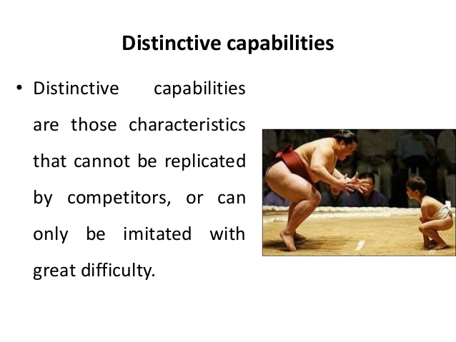

Slide 107
Restructuring
Another technique is the restructuring of the organization in which the methods of performing different functions are altered positively. In case of HR department, the majority of functions are still performed within the organization.
In some organizations the major functions of HR department are now transferred to the other parties in the shape of outsourcing, shared service center etc. The sizes of HR department in those organizations are shrinking because most of functions are performed by outsiders. But in most of the organizations the HR manager performs all the relevant functions of HRM. The HR department is now involved in the mission oriented & strategic activities.

Slide 108
Individual Challenges
The decisions related to the specific individual employees are included in the individual challenges for the HRM. The organizational issues are also affected by the fact that how employees are treated within the organizations. The problems related to the individual level are as follow.
Productivity
Empowerment
Brain drain
Ethics & social responsibility
Job insecurity
Matching people & organization

Slide 109
Productivity
Productivity is defined as the measure of the value that an employee can add to the final product or service of the organization. The increased output per employee is reflected as increased productivity.
Ability & motivation are two important factors that affect the employee productivity. The ability of the employee can be improved by the hiring & replacement along with the proper training & career development. On the other high quality of work life serves as accelerator to the motivational factor of the employees.

Slide 110
Empowerment
In the modern days many organizations make changes in such a way that their individual employees exert more control on their work as compared to their superiors.
This individual control of employees is called empowerment which helps the employees to work with enthusiasm, commitment & learn new skills because they are more make normal decisions about their work by themselves & hence enjoy their work.

Slide 111
Brain Drain
One of the challenges for HRM is the detachment of the key potential employees from the organization which link with the competitors for higher remunerations etc.
In such cases the organization loses its intellectual property & in many situations the leaving employees at the higher levels also take with them the potential lower level employees. This brain drainage is becoming serious issue in the High-Tec companies.

Slide 112
Ethics & Social Responsibility
Under this challenge, the organizations make an effort to benefit some portion of the society. This is now considered to the social responsibility of the organization to show favorable behavior towards the society. The ethics serves as the basic principle for the social behavior of the organizations. Within organizations, the HR departments develop a code of conduct & principles of code of ethics that serve as the guidance for the personal behavior of the employees of the organizations. The employees also expect from the management to show favorable decisions.

Slide 113
Job Insecurity
In the recent years, restructuring & downsizing develops the sense of insecurity of job within the employees of the organizations. Now many employees only desire to get a steady job rather than a job with promotional future. Even most successful organizations lay off its employees in the period of cut throat competition. The stock market also shows favorable results when layoffs has been made. All these things create a fear among employees about the insecurity of their jobs which would hinder their effective performance.

Slide 114
Matching People & Organizations
It has been proved from the research that the HR department contributes to the profitability of the organization when it makes such policies of employee selection in which those employees are selected & retained that best suits the culture of the organization & its objectives. For example it is proved from research that those employees would become beneficial for the high-Tech companies that can work in risky, uncertain environment having low pay. In short it is an important challenge for the HR department to hire and keep such employees whose abilities & strengths would match the requirements & circumstances of the organization

